Slide 1
Front End Engineering-I Project
Team Details: Krishna Bajaj (2210931008)
Aadit Bagga (2210990001)
Aadit Wadhwa (2210990002)
Aaditi (2210990003)
Faculty Coordinator:
:
Chitkara University Institute of Engineering and Technology,
Chitkara University, Punjab

Slide 2
Table of Contents
Introduction
Problem Statement
Technical Details
Key Features
Project Highlights
Bonus Feature(optional)
Conclusion
References/Links used

Slide 3
Introduction
Login authentication is a crucial aspect of web development. It ensures that only authorized users can access sensitive information or perform certain actions on a website. We have used a combination of HTML, CSS, and JavaScript to develop this login authentication page. HTML is used for creating the structure of the page, while CSS is used for styling the page, and JavaScript is used for implementing the functionality.
The purpose of this project is to create a secure and user-friendly login page that allows users to authenticate themselves before accessing the website's or application's restricted content.

Slide 4
Problem Statement
The problem statement behind making a login webpage is to ensure the security and privacy of a website or application's users. The login page provides a means of verifying the identity of the user before allowing access to restricted content or features. Without a login page, anyone could potentially access sensitive information or perform actions that are only intended for authorized users, leading to security breaches, data leaks, and other harmful consequences. Therefore, the login page is a crucial component of any website or application that requires user authentication, and it helps to protect users' personal information and maintain the integrity of the website or application.

Slide 5
Technical Details
The login authentication page is implemented using the following steps:
Step 1: Creating the HTML structure. The HTML code includes a form with three input fields for the username, email and password and a submit button. The form is enclosed within a div container.
Step 2: Styling the page with CSS. The CSS code is used to style the login form, including the input fields, submit button, and div container.
Step 3: Implementing the JavaScript code. The JavaScript code is used to handle the login functionality. When the user submits the form, the JavaScript code retrieves the username, email and password values and sends them to the server for verification. If the login credentials are correct, the user is redirected to the website's or application's main page. Otherwise, an error message is displayed.

Slide 6
Key Features
User authentication: The primary feature of a login authentication page is to authenticate the user before granting access to the website or application. This is done by requiring the user to enter a unique username and password or using other authentication methods such as biometrics or two-factor authentication.
Security: The login authentication page ensures the security and privacy of a website or application's users. It provides protection against unauthorized access to sensitive information, data leaks, and other harmful consequences.
Personalization: The login authentication page can also help to personalize the user experience by allowing users to save their preferences and track their activity on the website or application. This can improve user engagement and satisfaction, leading to a more successful and profitable product.
Error handling: The login authentication page should provide clear error messages if the user enters an incorrect username or password. This helps the user to identify and correct any errors and improves the overall user experience.
Accessibility: The login authentication page should be designed to be accessible to users with disabilities, ensuring that all users can access the website or application regardless of their abilities.

Slide 7
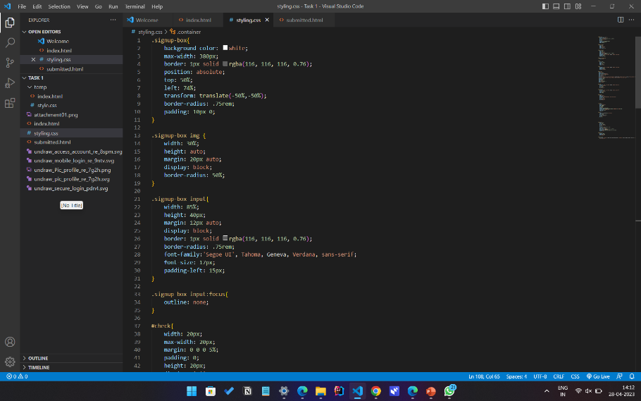
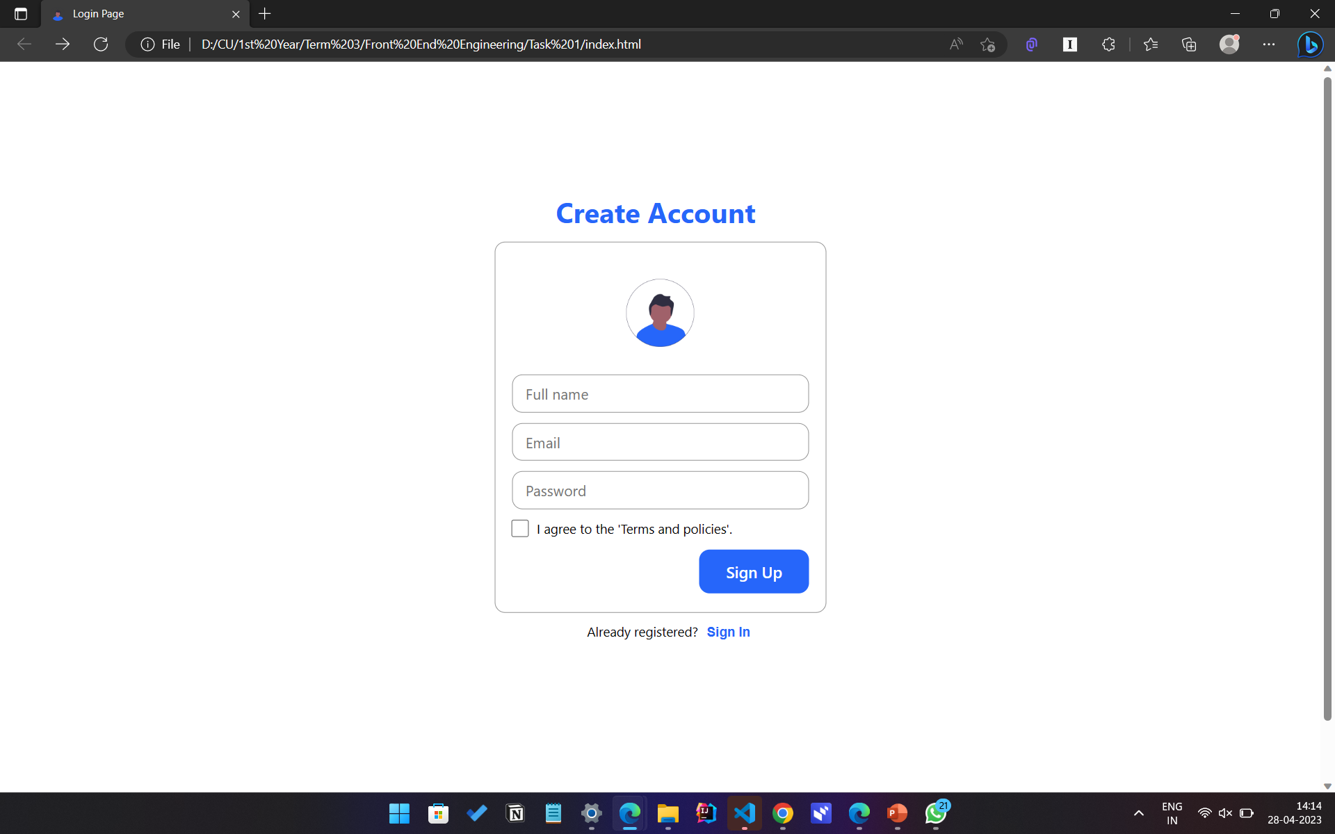
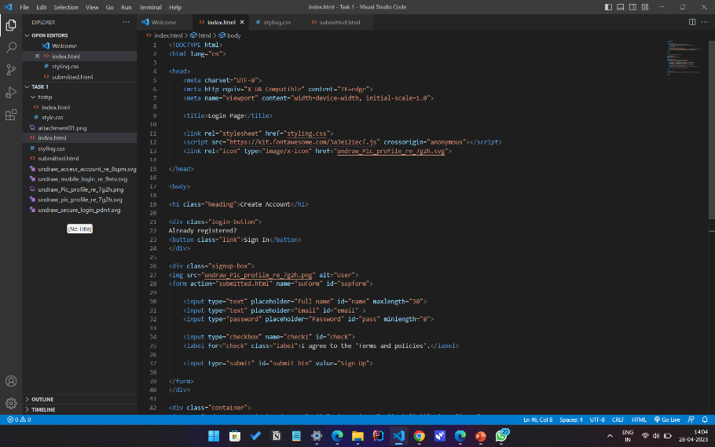
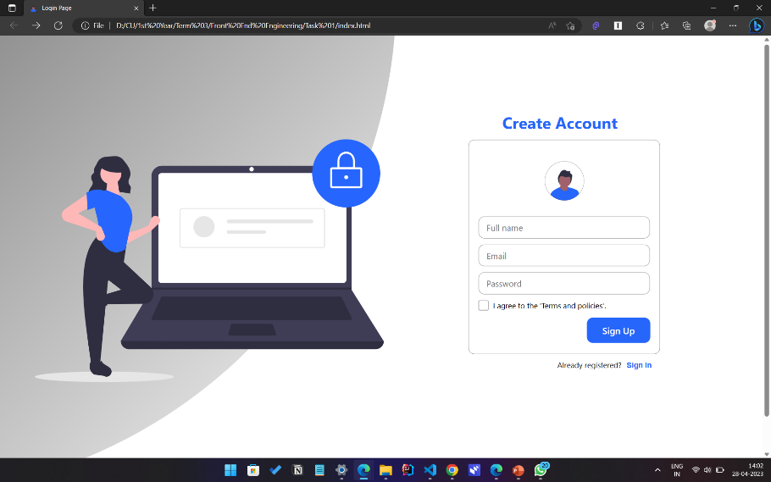
Project Highlights

Slide 8
Future Work
Future work and additional feature on this project could involve adding additional security measures such as two-factor authentication, implementing password reset functionality, and improving the overall user experience. Additionally, the login authentication page could be integrated into a larger web application or website for a more comprehensive user experience.

Slide 9
Conclusion
In conclusion, the login authentication page built using HTML, CSS, and JavaScript is an essential component of any website or application that requires user authentication.
This project has demonstrated how to create a secure and user-friendly login page using these technologies, providing a valuable resource for web developers and designers.

Slide 10
References/Links used
w3schools.com
youtube.com
canva.com
geeksforgeeks.com

Slide 11


